Slide 1
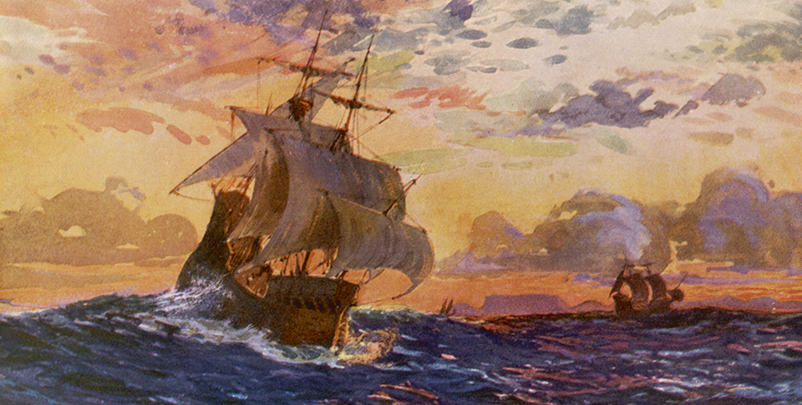
New Global Connections (1415-1796)
Topic 5 Lesson 1 Europeans Explore Overseas

Slide 2
New Global Connections (1415-1796)
Topic 5 Lesson 1 Europeans Explore Overseas
Key Terms
Moluccas,
Prince Henry,
cartographers,
Mombasa
Malindi,
Vasco da Gama
Christopher Columbus,
Treaty of Tordesillas
Line of Demarcation,
Ferdinand Magellan
circumnavigate,
Cape Town,
Boers,

Slide 3
New Global Connections (1415-1796)
Topic 5 Lesson 1 Europeans Explore Overseas
Learning Objectives
Understand the major causes of European exploration.
Analyze early Portuguese and Spanish explorations and expansion.
Describe how the Portuguese established footholds on Africa’s coasts.
Describe European searches for a direct route to Asia.

Slide 4
Causes of European Exploration
European Trade with Asia
After the Black Death and the breakup of the Mongol Empire disrupts trade with Asia it will return with Europe’s population growth
Moluccas islands will be named the Spice islands for producing cloves, cinnamon, and pepper. They are in Indonesia
The Drive to Explore
Europeans want to explore to cut out Muslim and Italian middle men to gain riches for themselves, convert others to Christianity, and to learn about other places in true Ren fashion
Improved Technology
Cartographers will make better maps and sea charts
The astrolabe, invented by the Greeks, will be perfected by the Arabs to be used to calculate latitude at sea
Portuguese will invent caravels, combining European ships with Arab sails and Chinese mast number. They will also have cannons

Slide 5
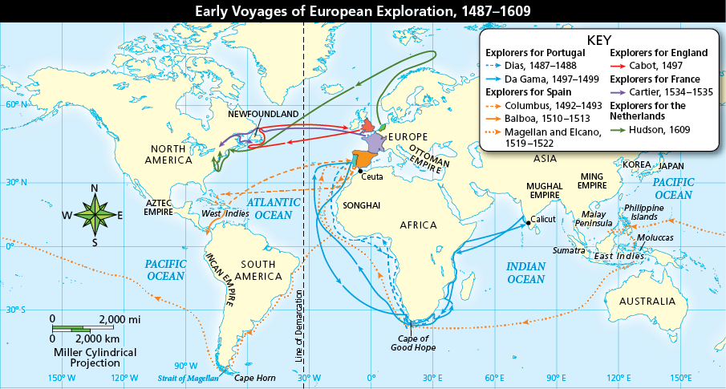
Causes of European Exploration
Analyze Maps Portugal led the way in exploring the world by ship. Spain and other countries soon followed. How did Magellan’s route to Asia differ from the routes of other explorers?

Slide 6
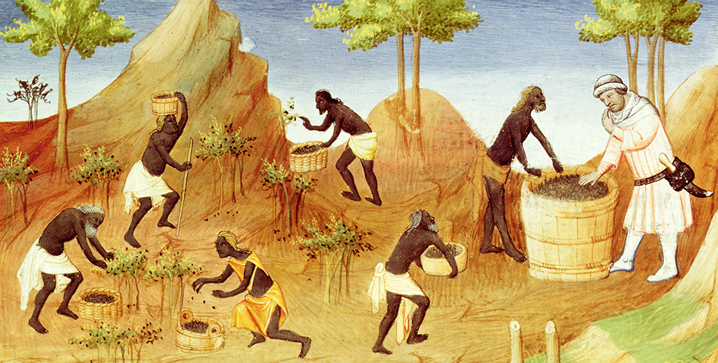
Causes of European Exploration
In this illustration from the 1400s, a French trader samples pepper harvested by workers.

Slide 7
Portugal Explores the Seas
The African Coast Mapped
Prince Henry wanted to explore Africa because he wanted to convert Africans to Christianity, find the source of Muslim gold, and find an easier way to reach Asia
Portuguese Footholds in Africa
They set up forts and trading posts to resupply ships and trade
They will attack Mombasa and Malindi, getting rid of Arabs and controlling the East Africa trade network for themselves
1488 Bartholomeu Dias will round the southern tip of Africa
Beyond Africa: Reaching India
1497 Vasco da Gama will go around the Cape of Good Hope and head to Calicut (India). He will lose half his ships on the way home but the profit he makes off his cargo will allow him to buy a new fleet. In 1502 he makes a treaty with the ruler of Calicut and leaves Portuguese merchants to buy goods when prices are low and store them for when the fleet comes back for them.

Slide 8
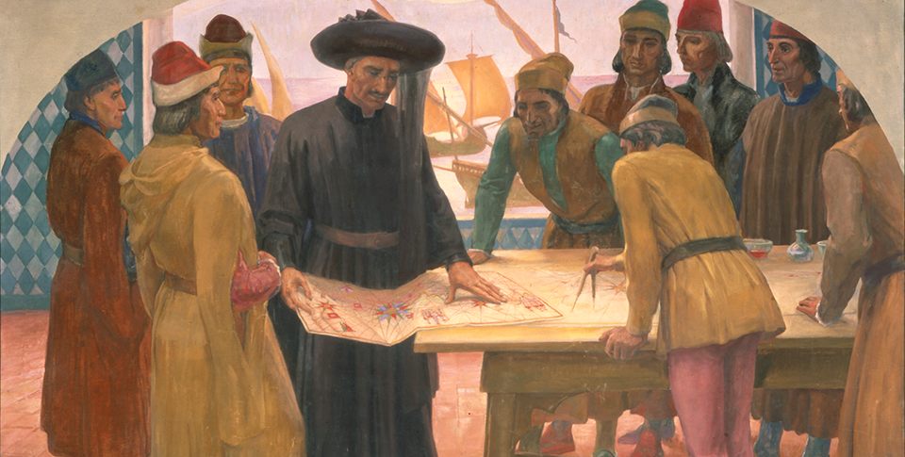
Portugal Explores the Seas
Prince Henry examines a chart with his men, as depicted by modern Portuguese artist Adriano de Sousa Lopes.

Slide 9
Columbus Searches for a Route to Asia
Reaching Faraway Lands
Columbus convinces Ferdinand and Isabella to sponsor him and they agree in the hope of bringing wealth and prestige to Spain
He discovers “The Indies” and returns home to a hero’s welcome
Before long other Europeans will realize Columbus has found previously unknown continents
Spain and Portugal Divide Up the World
In 1494 Spain and Portugal will sign the Treaty of Tordesillas with the help of the Pope. The treaty will set up a line of demarcation, with Spain having trading and exploration rights west of the line and Portugal east of the line. Other European countries will challenge this.
Naming the Western Hemisphere
Amerigo Vespucci will describe Brazil in a journal and a German cartographer will use description to make a map and he will name it America. The islands Columbus explored called West Indies

Slide 10
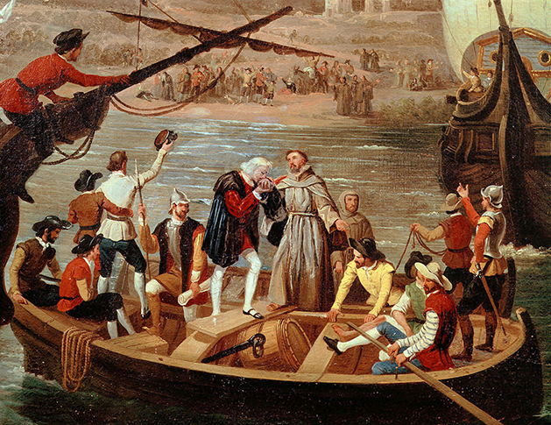
Columbus Searches for a Route to Asia
Amid much activity, Columbus prepares to depart Spain in August 1492, as shown in this fresco from the 1800s.

Slide 11
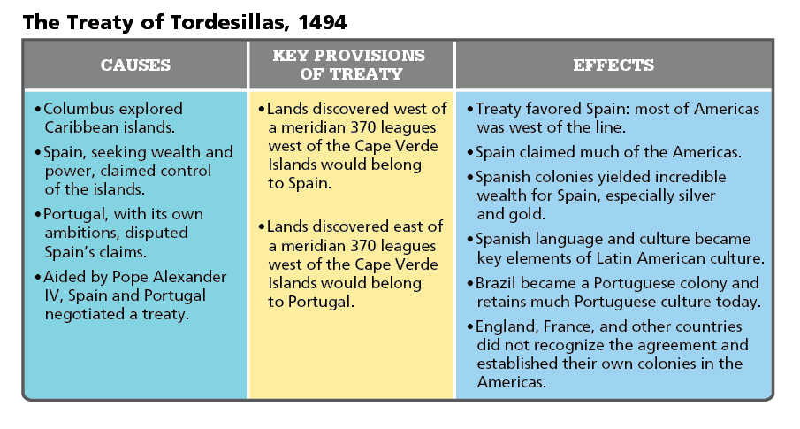
Columbus Searches for a Route to Asia
Analyze Charts The Treaty of Tordesillas resolved a major territorial dispute between Spain and Portugal. Whose rights and claims were not addressed by this treaty?

Slide 12
The Search for a Route to the Pacific
Magellan Sets Sail
In 1519 Magellan sets out with 5 ships trying to reach the Pacific Ocean. Traveling down the coast of South America he will find a passage that will be known as the Straights of Magellan
They will end in Balboa’s South Sea and Magellan will rename it Pacific, from the Latin word meaning peaceful
The Long Way Home
Magellan believed that 3 more weeks would leave them at the Spice Islands. He was wrong. 4 months later they reach the Philippines were Magellan is killed.
Sept 8, 1522 one ship with 18 sailors finally returns home to Spain. They will be the first people to circumnavigate the world

Slide 13
The Search for a Route to the Pacific
Months of careful planning, provisioning, and loading of supplies went into preparing for Magellan’s voyage. Even so, during the long voyage, regular stops for fresh food and water were required.

Slide 14
The Search for a Route to the Pacific
Analyze Charts Which explorers helped to find a western water route to Asia?

Slide 15
European Expansion in Africa
The Dutch Settle Cape Town
In 1652 Dutch settlers began to arrive at the southern tip of Africa and built Cape Town the 1st permanent European settlement in Africa.
Dutch farmers were called Boers settled around Cape Town, they had Calvinist belief that they were the chosen of God
Believed Africans inferior, so they ousted, enslaved or killed them
By 1700’s they will migrate north with ivory hunters and will fight the Zulus who they encounter
The British and French Explore
By mid 1600’s Brits and French have reached Senegal, French establish a fort by 1700’s. By late 1700’s stories of Brits searching for the source of the Nile River will spark an interest in exploring Africa. In 1788 Brits establish African Association, an organization that sponsors explorers to Africa. Next century European exploration of Africa will explode

Slide 16
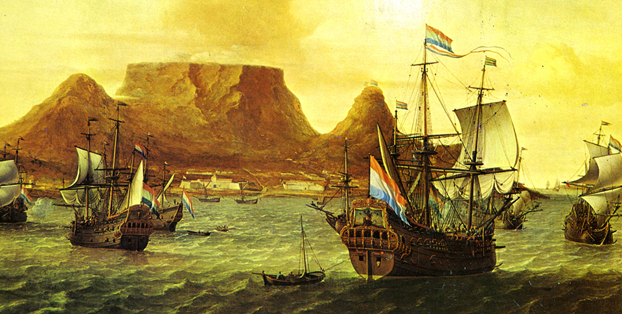
European Expansion in Africa
In the late 1600s, the Dutch colony at Cape Town was busy with arriving and departing ships.

Slide 17
Quiz: Causes of European Exploration
Which was a major cause of European exploration?
A. the need to reduce Europe’s population
B. a desire for direct access to spices
C. the need to limit the growth of Arab empires
D. a desire for better fishing grounds

Slide 18
Quiz: Portugal Explores the Seas
Portuguese explorers created a trading empire by
A. negotiating agreements with local leaders.
B. marrying local women and building settlements.
C. discovering a sea route around Africa to India.
D. discovering new inland trading opportunities.

Slide 19
Quiz: Columbus Searches for a Route to Asia
How did Spain benefit from the Treaty of Tordesillas and Line of Demarcation?
A. Spain won exploration and trading rights over half of the non-European world.
B. Portugal had to surrender its African forts.
C. Spain gained territory in Europe.
D. Spain no longer had close ties to the Catholic Church.

Slide 20
Quiz: The Search for a Route to the Pacific
How did Balboa’s discovery affect European exploration?
A. It allowed explorers to form alliances with Native American groups in the Caribbean.
B. It encouraged explorers to seek a direct sea route to the Pacific and the East Indies.
C. It discouraged explorers from searching for a northwest passage to the East Indies.
D. It challenged explorers to find a shorter route past the Cape of Good Hope to India.

Slide 21
Quiz: European Expansion in Africa
Which describes the main reason why European powers expanded their presence in Africa?
A. to explore African rivers and learn about African plants and animals
B. to cooperate with other European powers to spread Christianity throughout Africa
C. to expand their trade in Africa, the Indian Ocean, and India
D. to make agreements with African leaders to work and trade together with Arab traders

